Slide 1
2020
Share Securely
Add a slide or two to your PowerPoint presentations or use as introductions to your Zoom meetings.

Slide 2
Know Your Data
Cyber Security Tip # 5
Add passcode protection and expiry dates when sharing links to recorded Zoom meetings.

Slide 3
Know Your Data
Cyber Security Tip # 4
Store sensitive data in Harvard-managed locations, like Google Drive, OneDrive or SharePoint.

Slide 4
Know Your Data
Cyber Security Tip # 3
Keep your team on the same page and protect your data. Send links instead of files when sharing with your team.

Slide 5
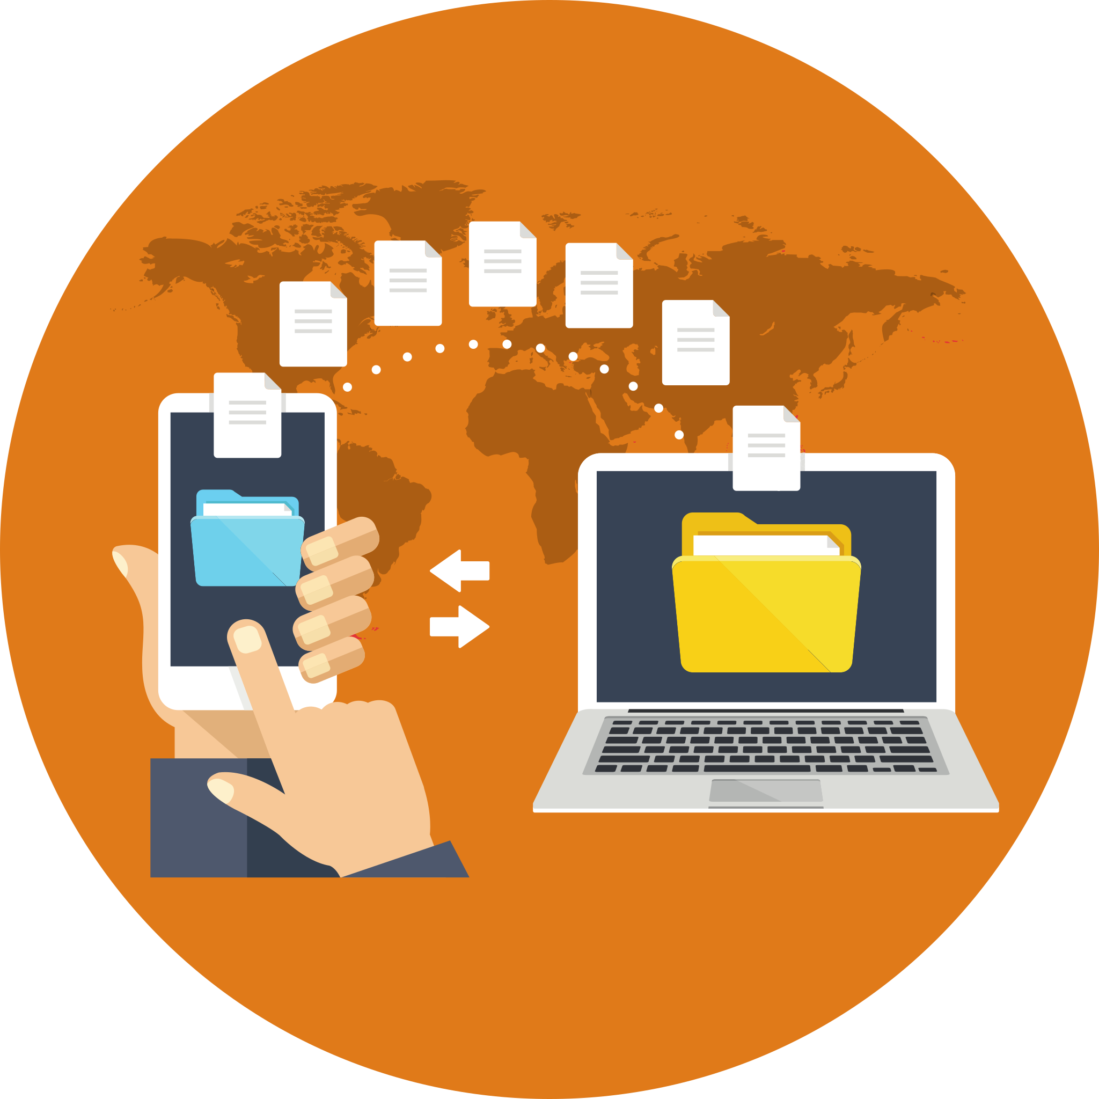
Know Your Data
Cyber Security Tip # 2
Use the OneDrive app to securely scan documents to the cloud with a simple tap.

Slide 6
Know Your Data
Cyber Security Tip # 1
Thieves can’t steal files that aren’t there.
Protect the data you need, delete the data you don’t.

Slide 7
2019
Small Actions
Add a slide or two to your PowerPoint presentations or use as introductions to your Zoom meetings.

Slide 8
Use Strong Passwords
Cyber Security Tip # 6
Use strong, unique passwords for every account. It’s simple when you use a Password Manager like LastPass.

Slide 9
Know Your Data
Cyber Security Tip # 8
Keep control of your data by sending links instead of files. You can’t unsend a file, but you can unshare a link.

Slide 10
Apply Updates
Cyber Security Tip # 11
Security update ready? Take a pause for patching. You deserve a break, and your computer deserves to be secure.

Slide 11
Click Wisely
Cyber Security Tip # 14
Is that really you?
If you get an odd request from someone you know, verify it by phone call or text.

Slide 12
2018
Use Security Resources
Add a slide or two to your PowerPoint presentations or use as introductions to your Zoom meetings.

Slide 13
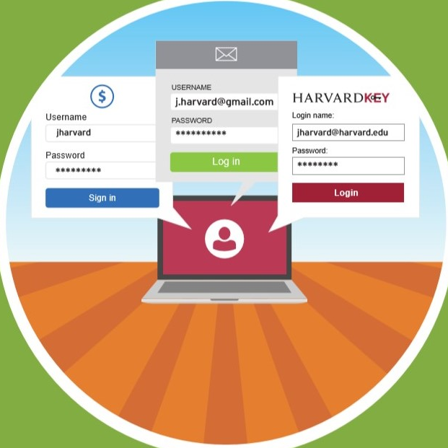
Use Strong Passwords
Cyber Security Tip # 7
Use unique passwords for every account.
That way, if one is stolen, your other accounts are still safe.

Slide 14
Know Your Data
Cyber Security Tip # 9
Store and transfer sensitive data securely by following the Information Security Quick Reference Guide.

Slide 15
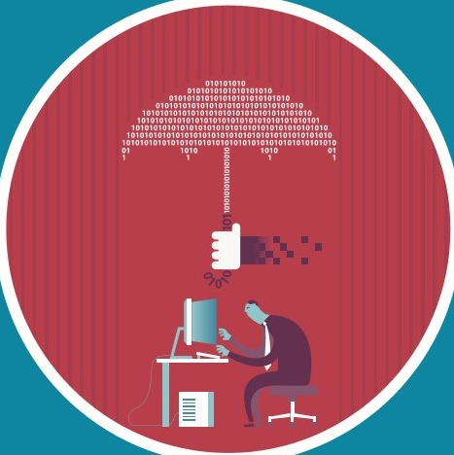
Apply Updates
Cyber Security Tip # 12
Restart your computer weekly to make sure software updates from Support Services take effect.

Slide 16
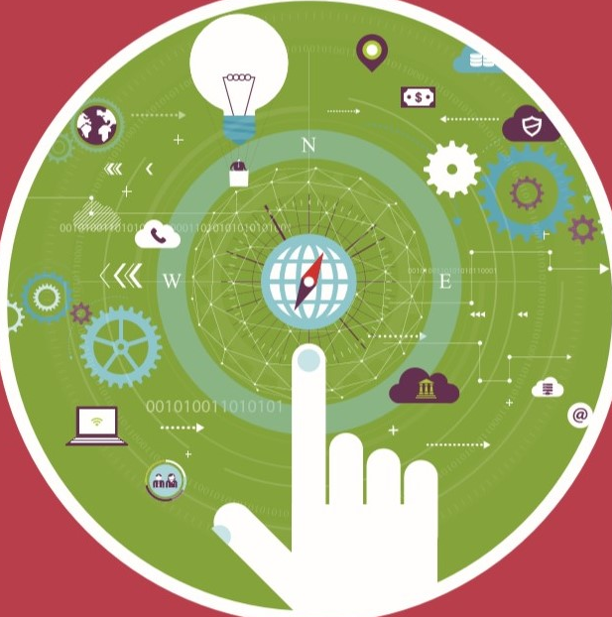
Click Wisely
Cyber Security Tip # 13
Forward suspicious emails to phishing@harvard.edu.
Deleting protects you. Reporting protects everyone.

